Slide 1
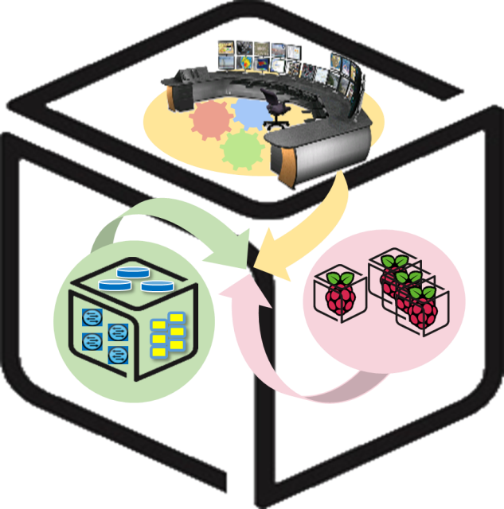



Computer Systems
For AI-inspired Cloud
Theory & Lab.
Lab #0: Overview
https://github.com/SmartX-Labs/SmartX-Mini-MOOC

Slide 2
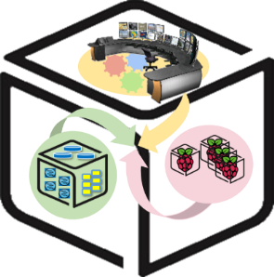
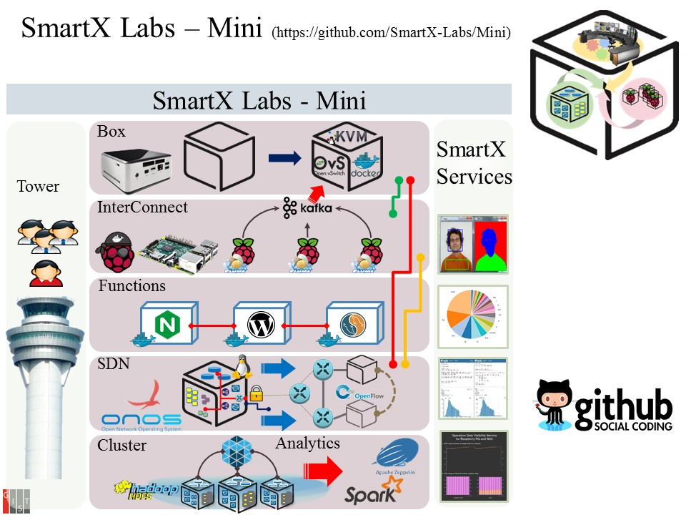
SmartX Labs – Mini (Full Selection)
https://github.com/SmartX-Labs/SmartX-Mini
SmartX Labs – Mini is focusing on how to enable inter-connected service functions (i.e., microservices) with IoT devices (e.g., Raspberry Pi’s) linked to cloud (e.g., NUCs). Lab participants first install/configure Boxes (Pis & NUCs) according to their roles, then connect both IoT and Cloud Boxes to conduct diverse miniaturized service realization while the centralized Tower Box can monitor & control IoT/Cloud Boxes.

Slide 3



Selected Labs

Slide 4
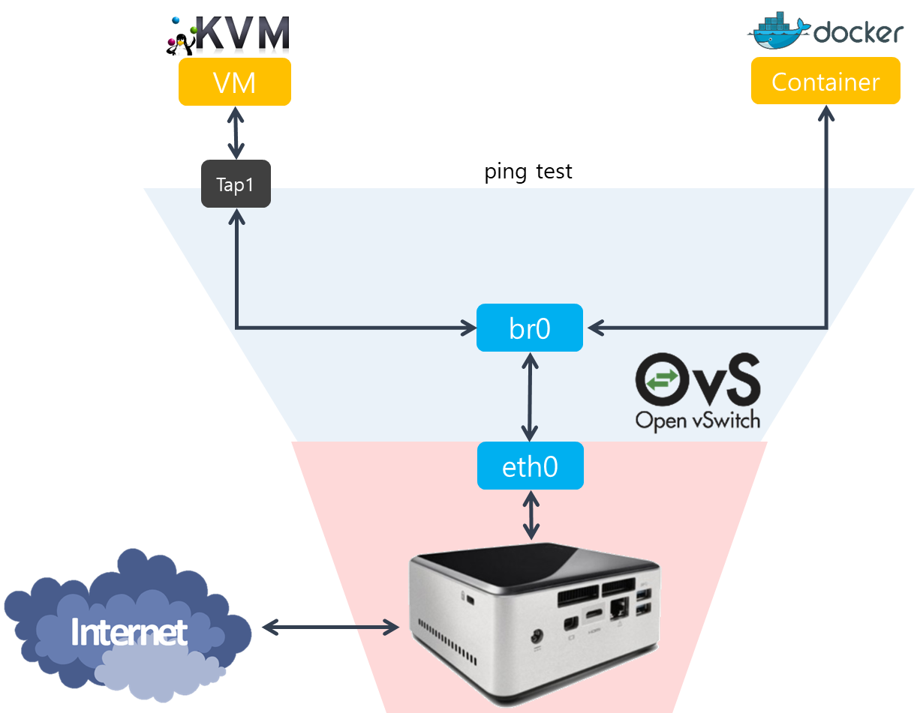
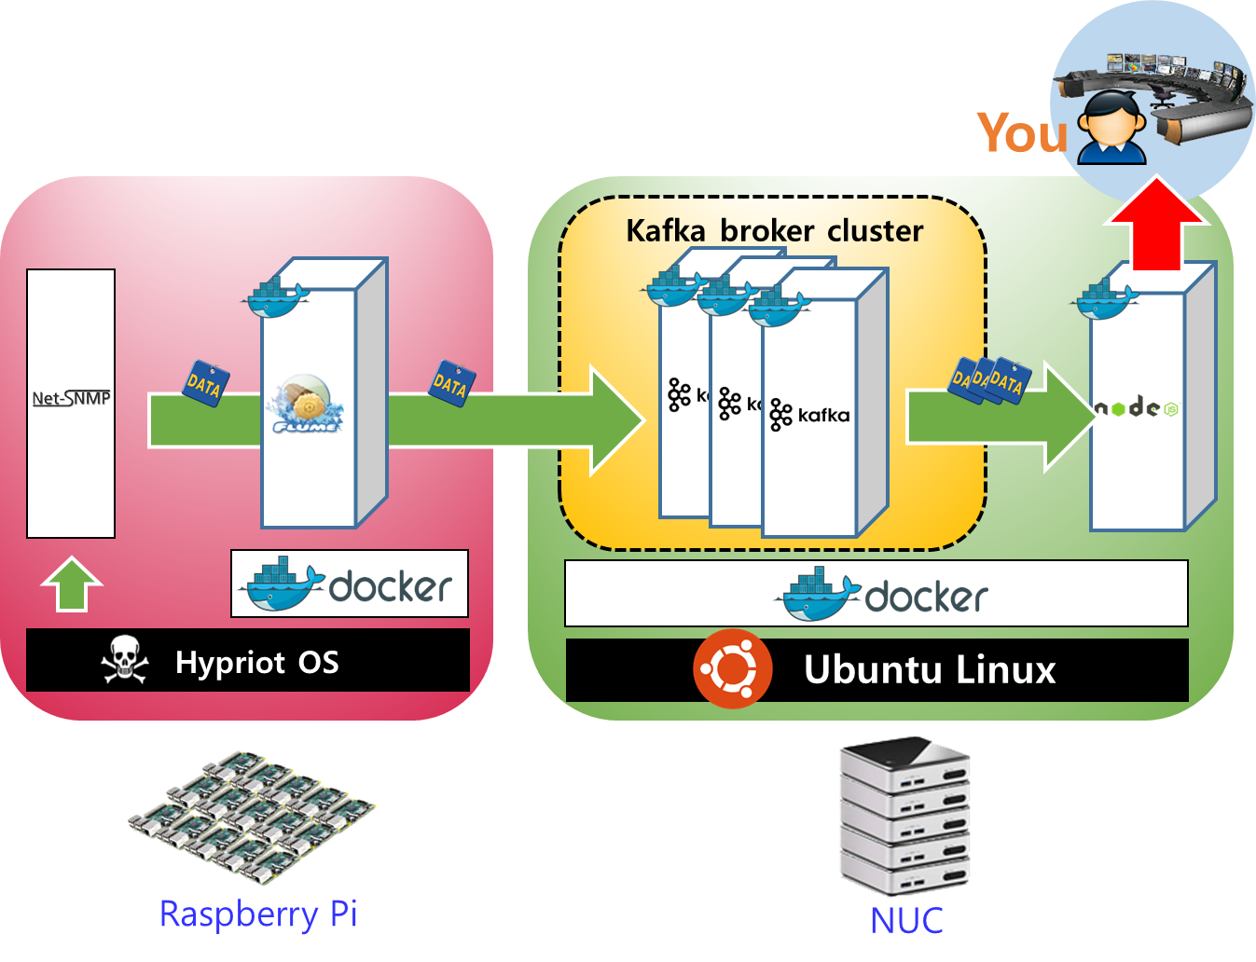

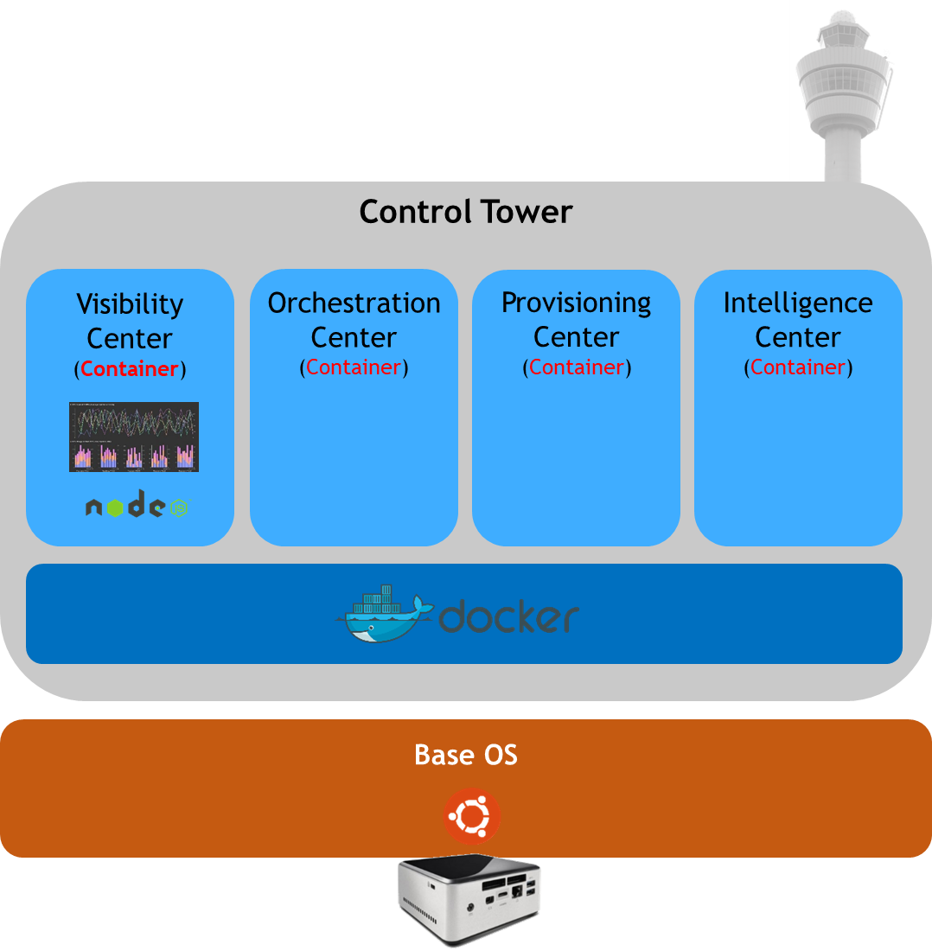

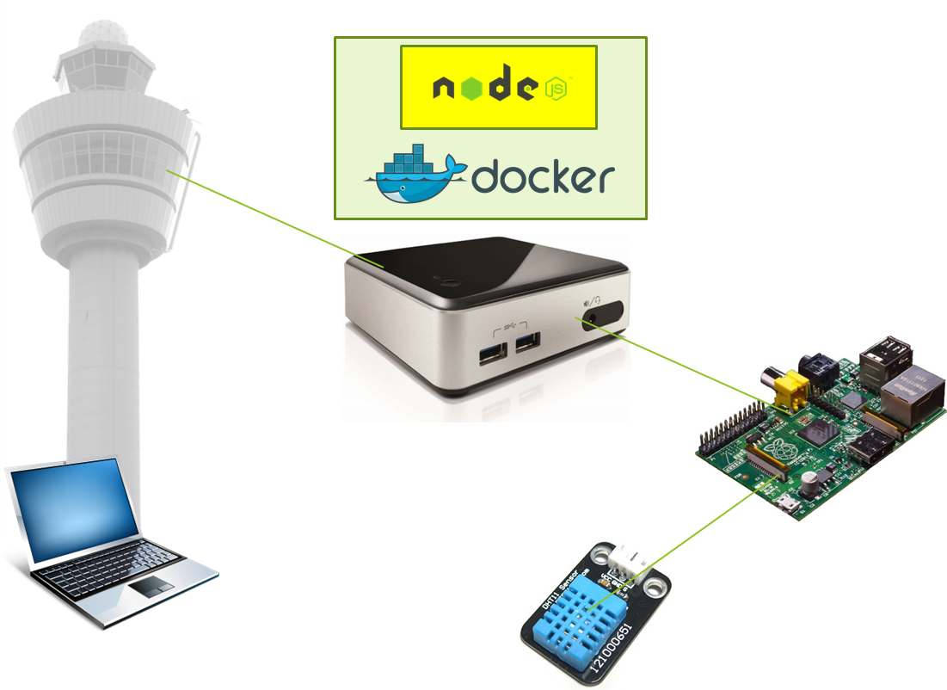
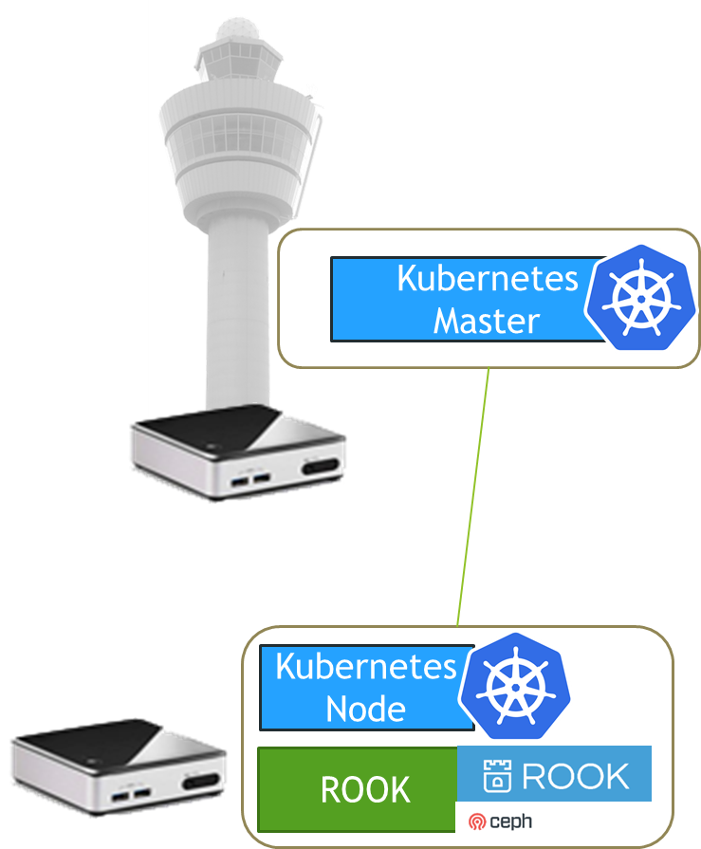
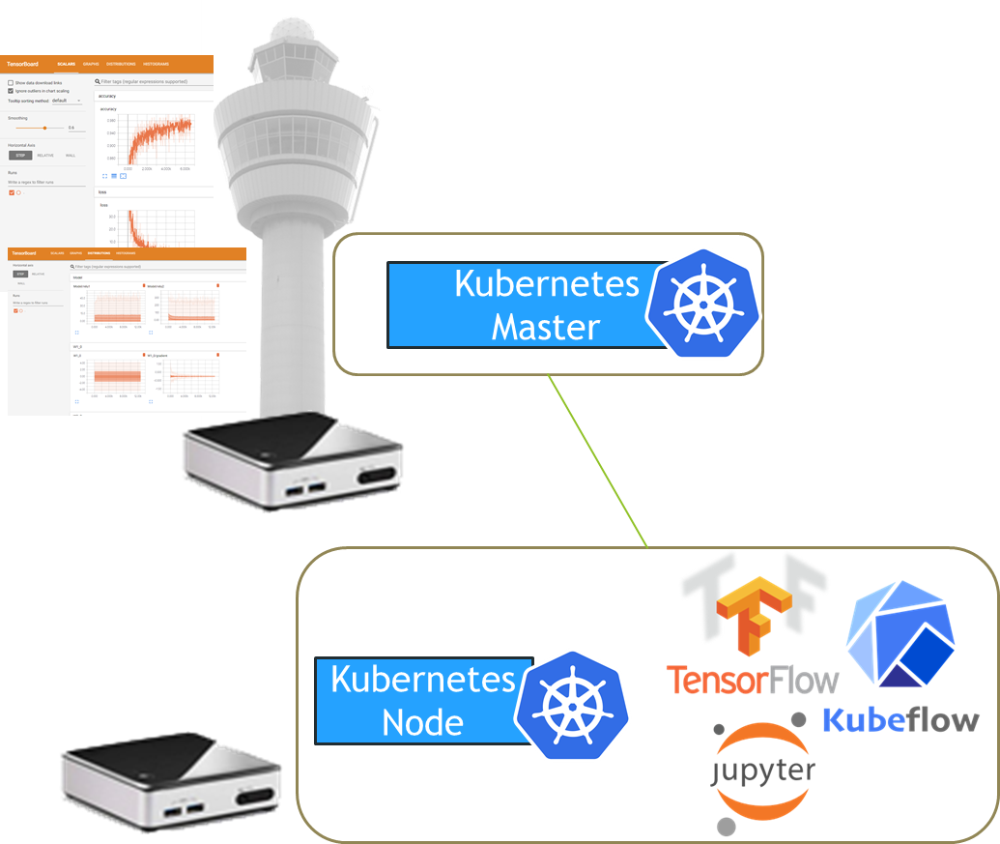
SmartX Labs - Mini-MOOC Selections
https://github.com/SmartX-Labs/SmartX-Mini-MOOC
#1: Box Lab
#2: Inter-Connect Lab
#3: Tower Lab
#4: IoT Lab
#5: Cluster Lab
#6: Analytics Lab

Slide 5
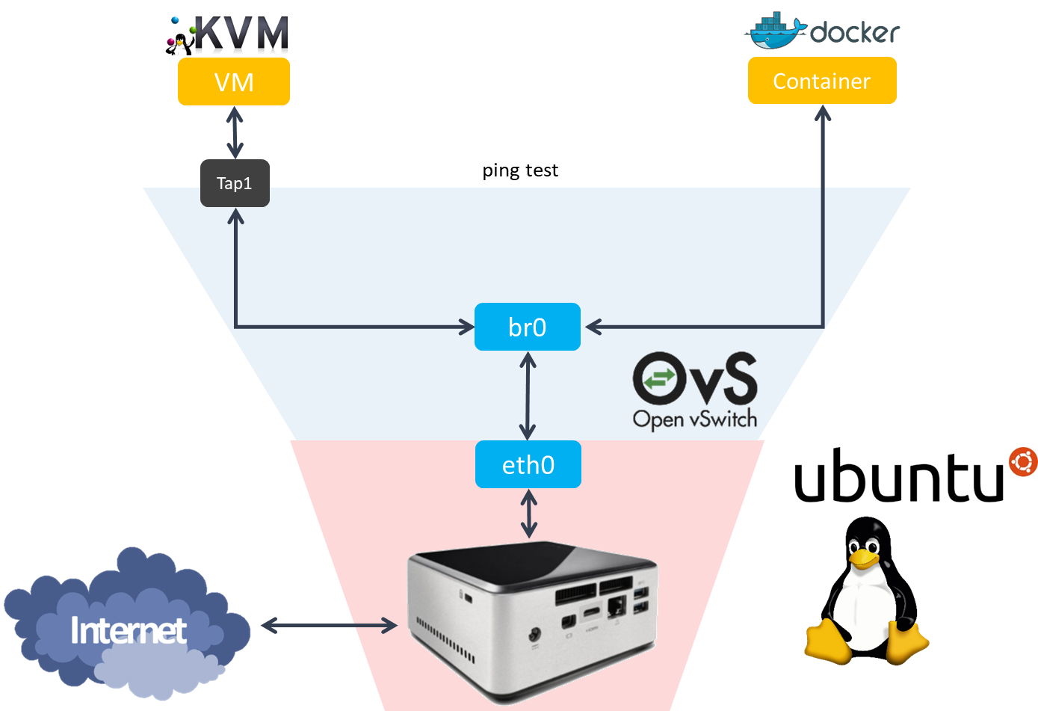
SmartX Labs Mini-MOOC: #1 Box Lab

Slide 6
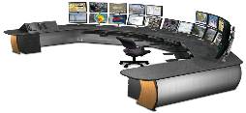









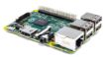
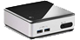
SmartX Labs Mini-MOOC: #2 Inter-connect Lab
Kafka broker cluster
Hypriot OS
Ubuntu Linux
Raspberry Pi
NUC

Slide 7
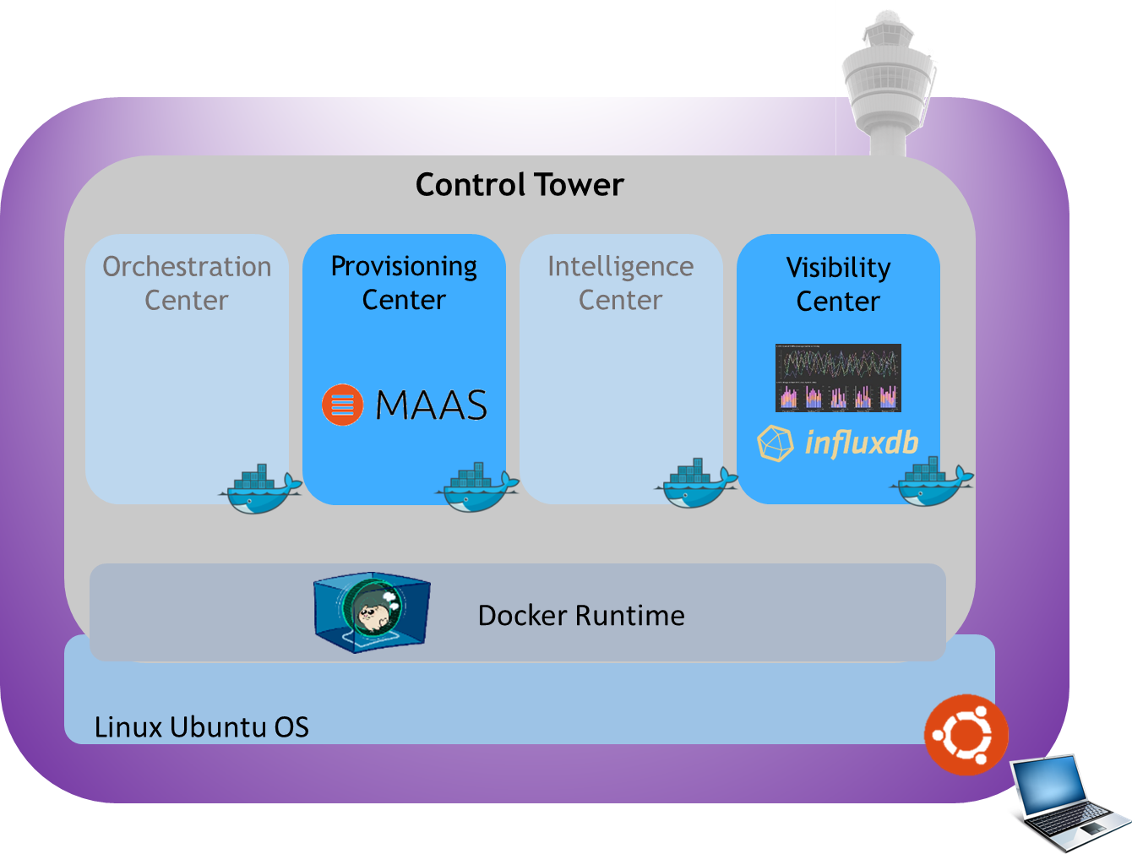
SmartX Labs Mini-MOOC: #3 Tower Lab

Slide 8
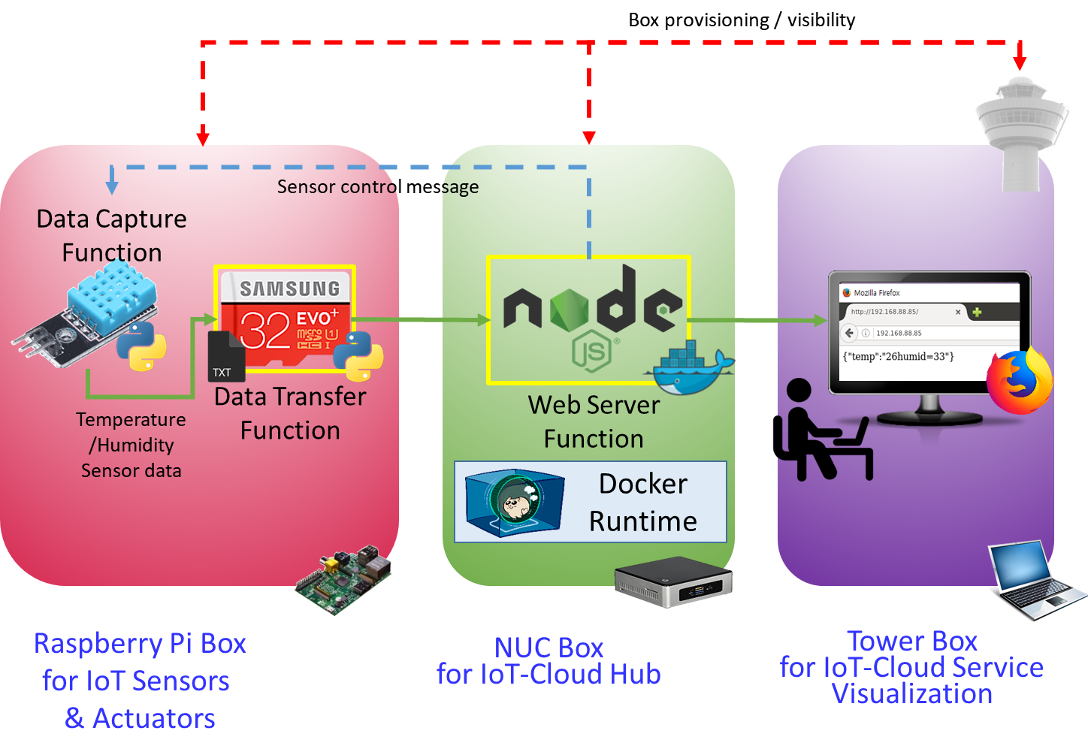
SmartX Labs Mini-MOOC: #4 IoT Lab

Slide 9
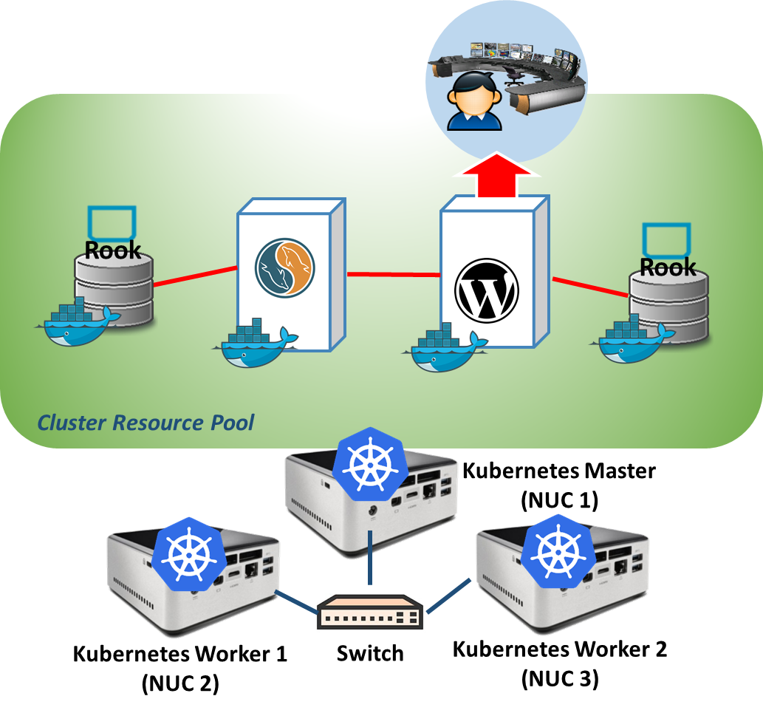
SmartX Labs Mini-MOOC: #5 Cluster Lab

Slide 10
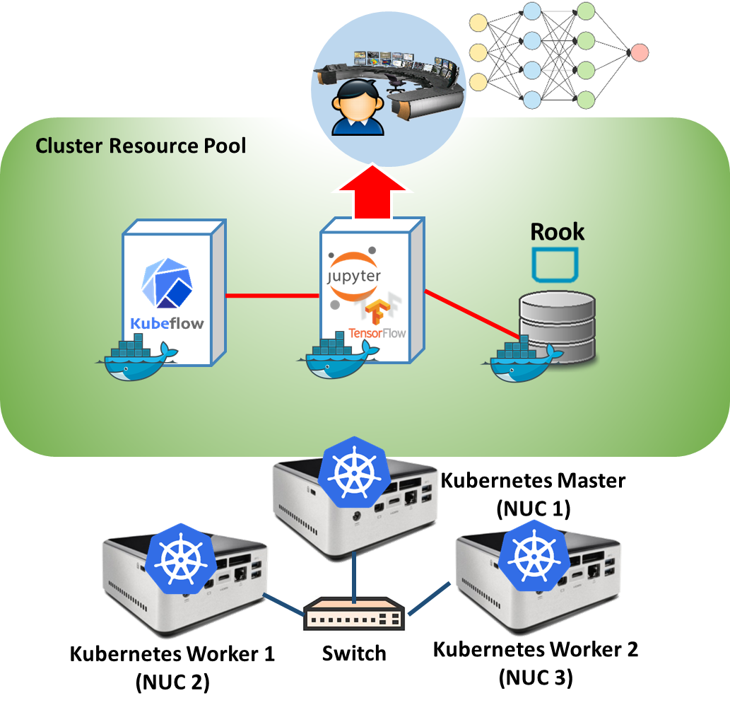
SmartX Labs Mini-MOOC: #6 Analytics Lab

Slide 11
Labs Setup

Slide 12
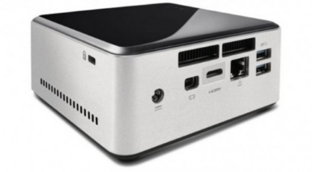
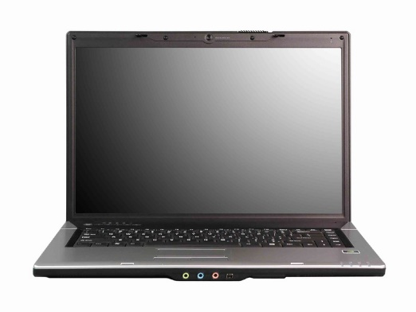
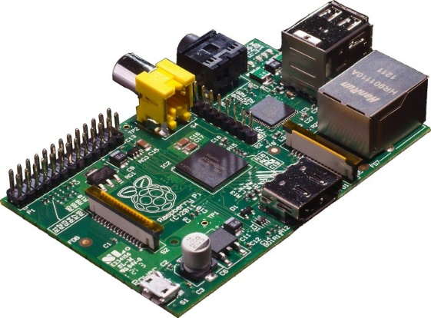

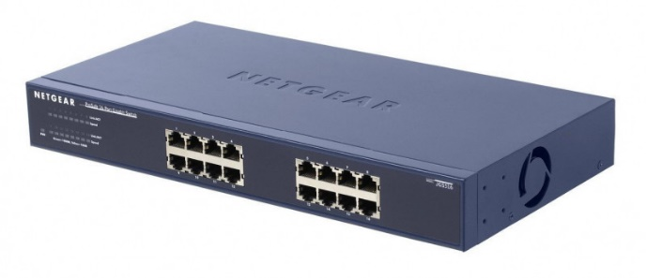
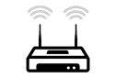
Model: NUC5i5MYHE CPU: i5-5300U @2.30GHz / 4 cores Memory: 16GB DDR3 HDD: 94GB
Lab Setup: Required Devices
PI
NUC PC
Laptop (or NUC)
Model: Raspberry Pi 2 Model B
CPU: ARM Cortex A7 @900MHz / 4 cores Memory: 1GB SD Card: 32GB
Model: NT900X3A CPU: i5-2537U @1.40GHz / 2 cores Memory: 4GB DDR3 SSD: 128GB
Note: Any qualified PCs or switches can replace above required devices.
Switch (and/or WiFi AP)
Model: Netgear Prosafe 16 port 1G switch Network: 16 auto-sensing 10/100/1000 Mbps Ethernet ports

Slide 13

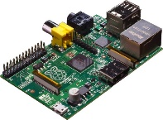
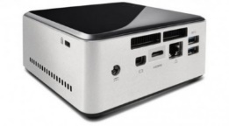
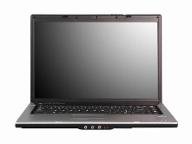
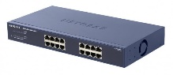
Lab Setup: Network Setting Choices
Wired/Wi-Fi connection (Ideal case)
Connection case
Wired/Wireless connection (Ideal case)
Wireless connection
Wired connection
Legends (Network Channel)
Wired Data Network
Wired Data Network
Wired Control Network
Wired Control Network
2. Wi-Fi connection
3. Wired connection

Slide 14
Thank You for Your Attention
Any Questions?
mini@smartx.kr

Slide 15

Acknowledgement
Fall 2018
총괄: 김종원 교수님
실습 담당 조교: 이승형, 김주성
감수 담당 조교: 권진철
1. Box Lab 자료 제작 도움: 배정주, 윤희범, 남택호, 강문중, 권진철, 김주성, 이승형, 홍유진
2. Inter-connect Lab 자료 제작 도움: 김승룡, 강문중, 김주성, 이승형, 홍유진
3. Tower Lab 자료 제작 도움: 김병돈, 김승룡, 김진우, 김주성, 이승형, 김은지
4. IoT Lab 자료 제작 도움: 배정주, 권진철, 김주성, 이승형, 홍유진
5. Cluster Lab 자료 제작 도움: 송지원, 김승룡, 윤희범, 남택호, 강문중, 권진철, 이승형, 김은지
6. Analytics Lab 자료 제작 도움: 송지원, 김승룡, 윤희범, 남택호, 강문중, 권진철, 이승형, 김은지

